Slide 1
Sakai: The Future of Learning Management Systems
Dr. Charles Severance
University of Michigan
LongSight
IMS
Pedagogy and Technology Conference 2015

Slide 2

Disclaimer
What I am about to talk about is not an official direction or position of the University of Michigan, Longsight, nor IMS Global.

Slide 3

Disclaimer
What I am about to talk about is not an official direction or position of the University of Michigan, Longsight, nor IMS Global.

Slide 4
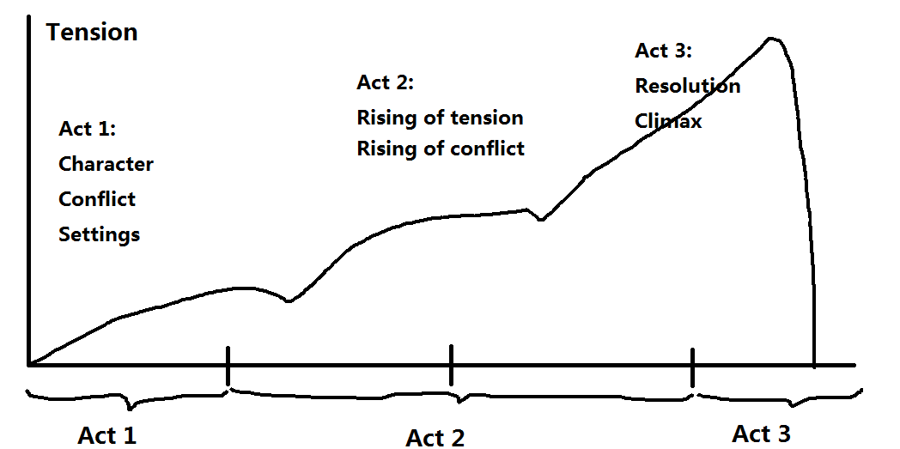
A Three-Act LMS Play
https://en.wikipedia.org/wiki/Three-act_structure

Slide 5
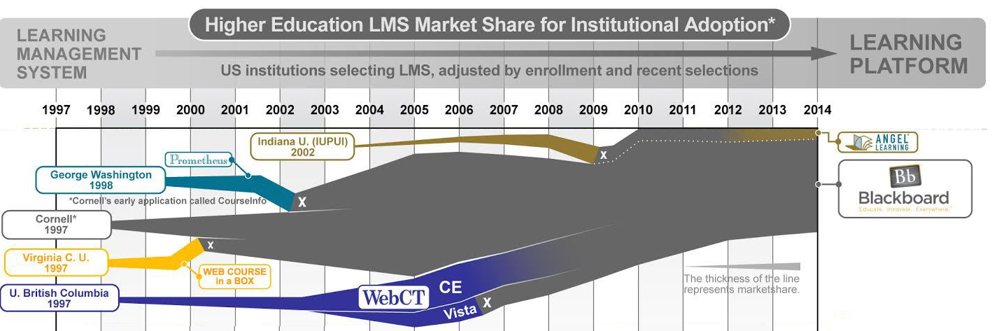
Act I – Lone Prospectors

Slide 6
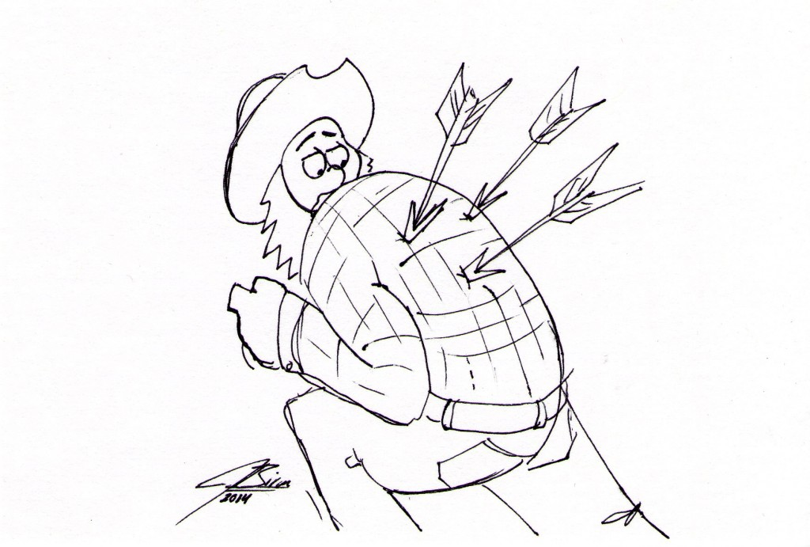
Foreshadowing
Learn and Learn+WebCT reach maximum market share in 2005

Slide 7





Act I - Summary

Slide 8
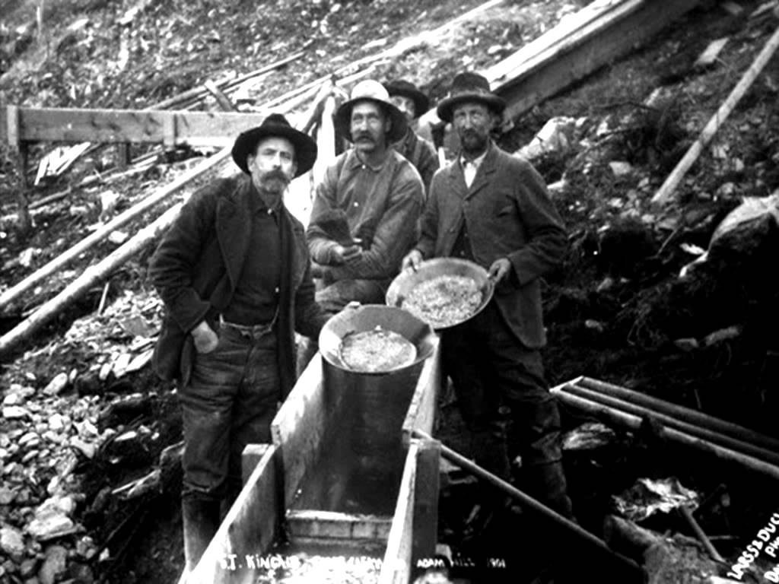
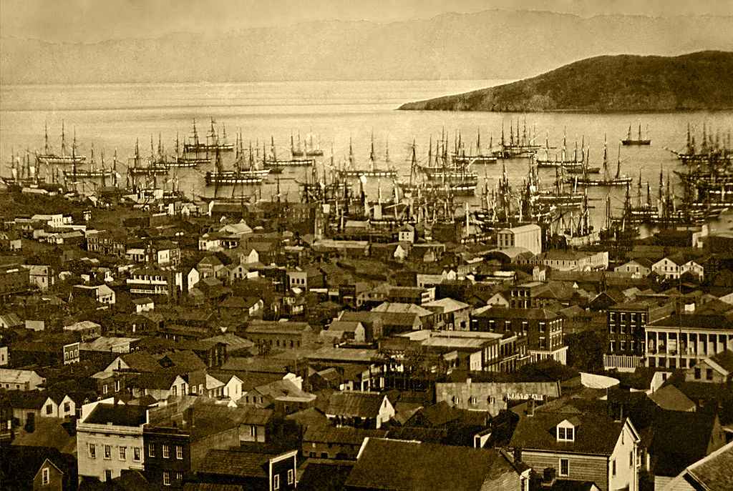
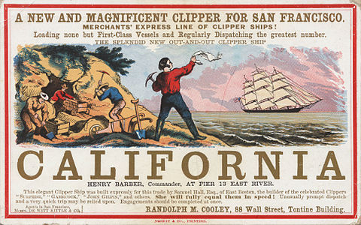
Act II Starts – Gold Rush

Slide 9
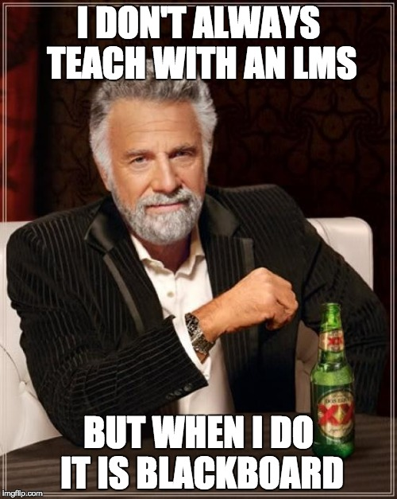

Slide 10

D'Arcy Norman's Law of eLearning Tool Convergence
Any eLearning tool, no matter how openly designed, will eventually become indistinguishable from a Learning Management System once a threshold of supported use-cases has been reached.
http://darcynorman.net/2013/02/15/normans-law-of-elearning-tool-convergence/

Slide 11
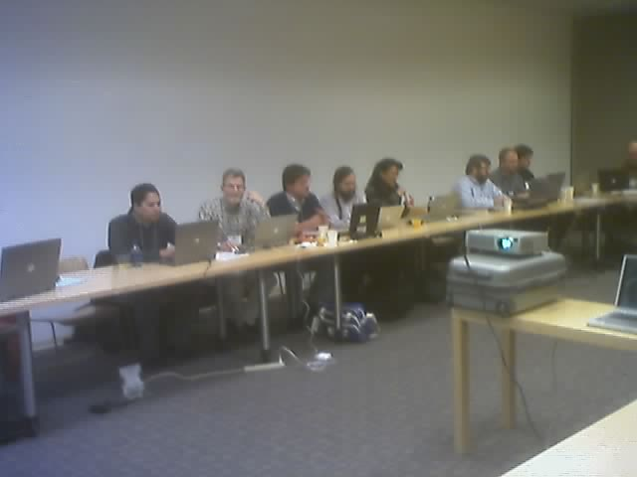
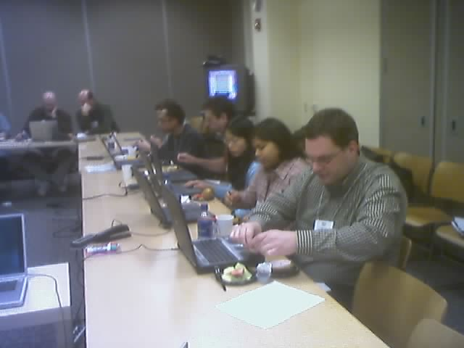
Team Sakai (2004)

Slide 12
A Three-Act LMS Play
https://en.wikipedia.org/wiki/Three-act_structure

Slide 13
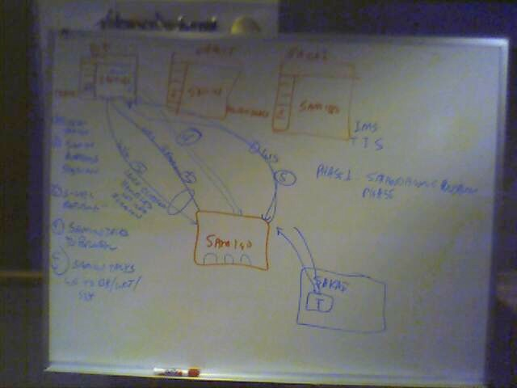
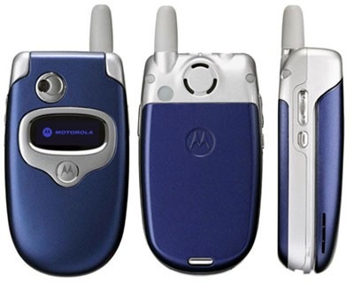
IMS LTI Begins
Brainstorming at IMS Meeting in Denver 2004-10-19

Slide 14
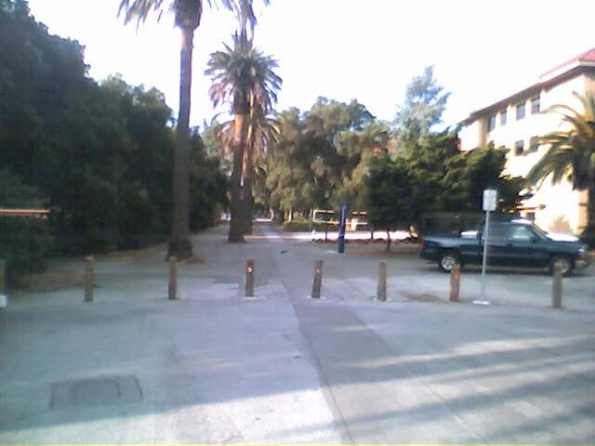
Publisher Meeting @ Stanford
Colleagues:
It looks like we have about 25 individuals (give or take) attending the SCP/SCA/Board meeting on 4/27/2005 from 1-5 pm. This includes the Board (9). See list below. At this point, I'd rather not invite any more people.
Textbook Publishers Invited/Attending...............................................
Allen Noren, O'Reilly & Associates -- ATTENDING
Ray Henderson, Pearson Education -- ATTENDING
Schoen, Steve, Thomson Higher Education -- ATTENDING
David Serbun, Houghton Mifflin Company -- ATTENDING
Jonathan Stowe, John Wiley & Sons, Inc. -- ATTENDING
Glenn Kammen, Intelecom -- ATTENDING
Vivian 'Vivie' Sinou
Dean, Distance & Mediated Learning
Foothill College

Slide 15
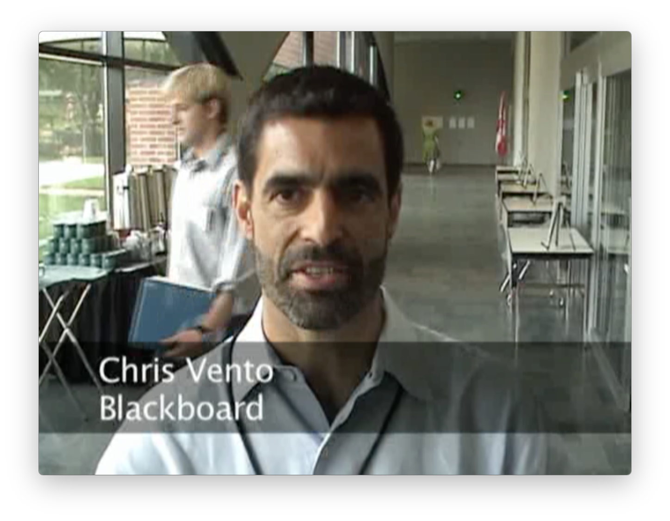
https://www.youtube.com/watch?v=nOvNDey2QLI

Slide 16
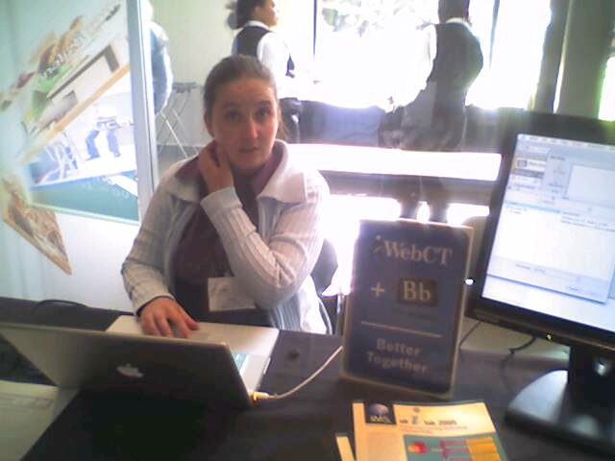
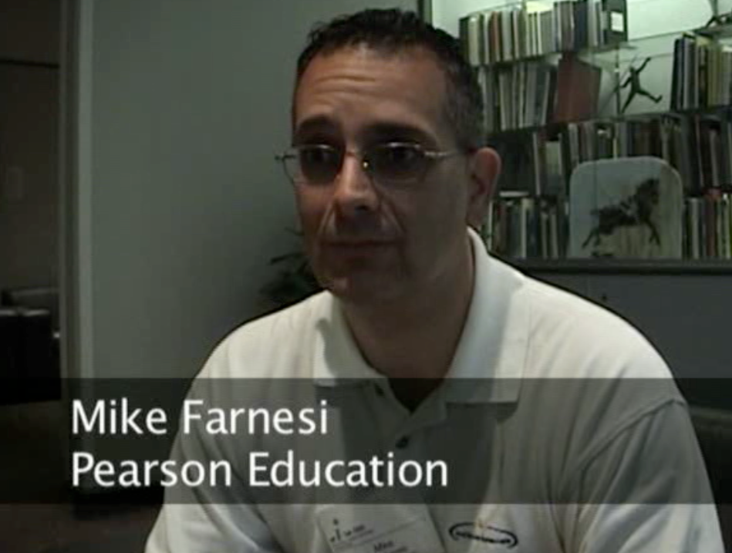
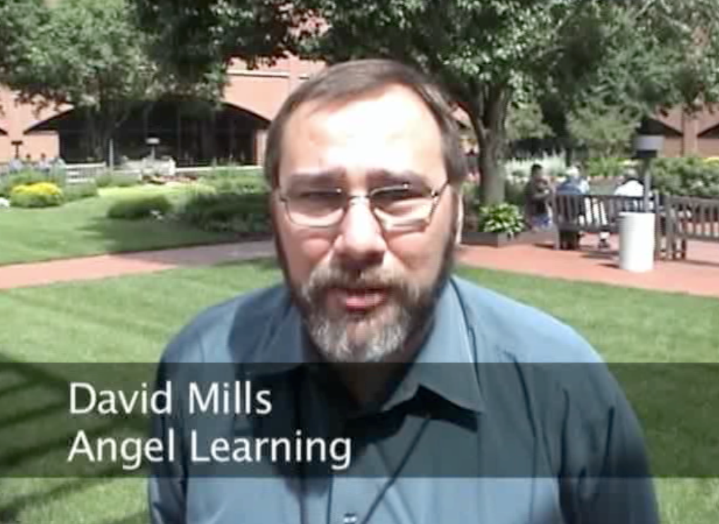
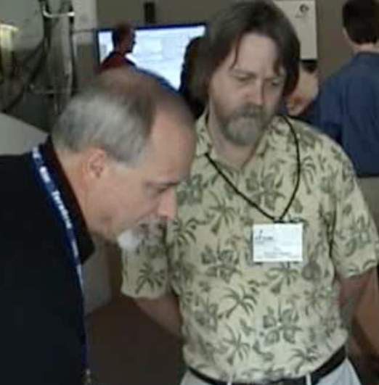
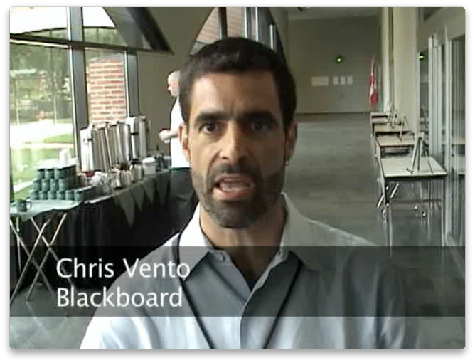
June 21, 2006
IMS Alt-I-Lab
Indianapolis, IN

Slide 17
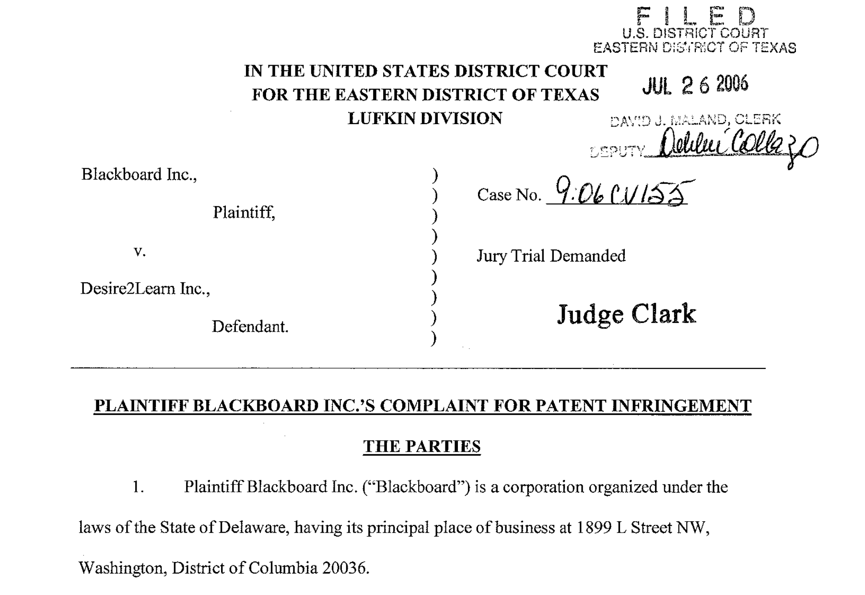

Slide 18
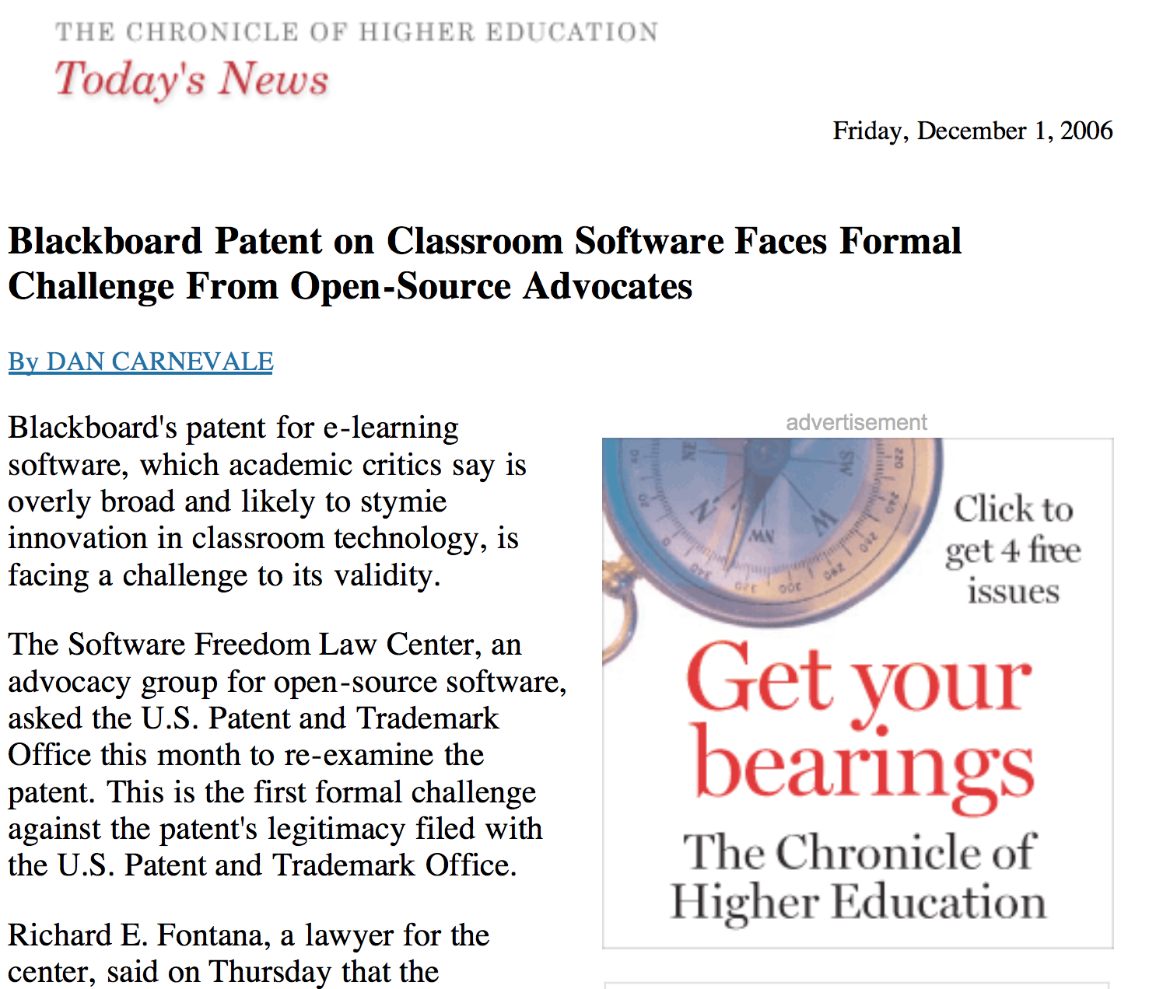
Patent Wars

Slide 19
Standards Completed
IMS Tools Interoperability – Feb 28, 2006
IMS Common Cartridge 1.0 – October 2008
IMS LTI 1.0 – June 15, 2010
IMS Common Cartridge 1.1 – May 2011
IMS LTI 1.1 – August 2012

Slide 20
Patent Resolved
Open Source – February 2007
Desire2Learn – December 2009

Slide 21
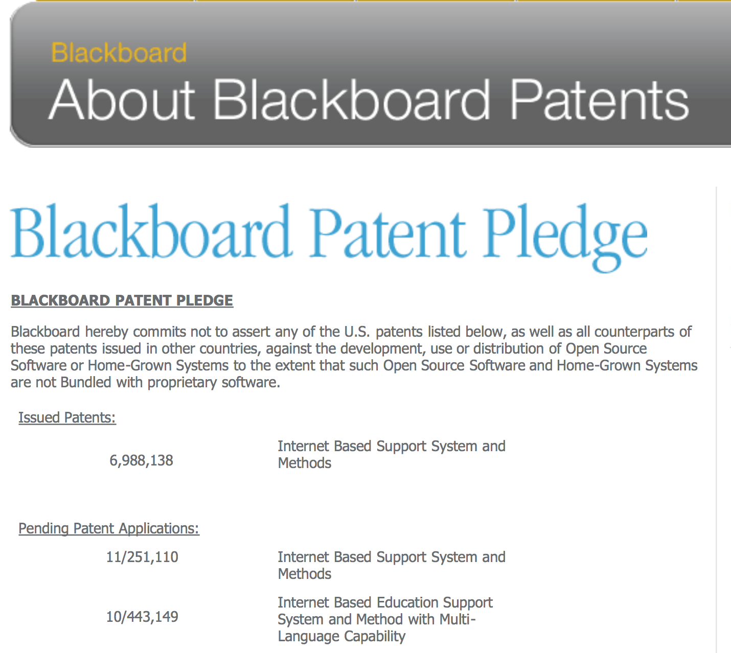

Slide 22
A Three-Act LMS Play
https://en.wikipedia.org/wiki/Three-act_structure

Slide 23
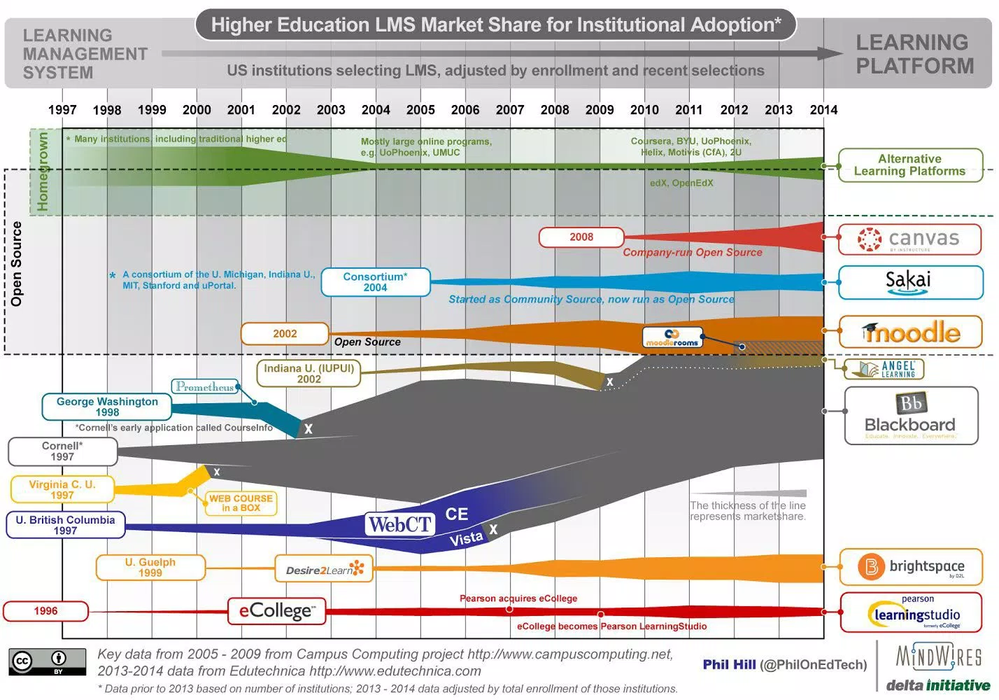
http://mfeldstein.com/back-to-the-future-looking-at-lms-forecasts-from-2011-2014/

Slide 24
If you were going to write an LMS in 2008....
You would build it based on IMS LTI as *the* integration strategy
You would use IMS Common Cartridge as the import and export format
You would slickly extend both specs to make next-generation integrations

Slide 25

If you were going to write an LMS in 2008....
You would release *part* of your LMS as open source so Blackboard could not sue you under its patents....
You would make nice REST/JSON APIs for everything
You would not use iframes or framesets
You would use JQuery
You would not support IE 6

Slide 26
http://mfeldstein.com/back-to-the-future-looking-at-lms-forecasts-from-2011-2014/

Slide 27
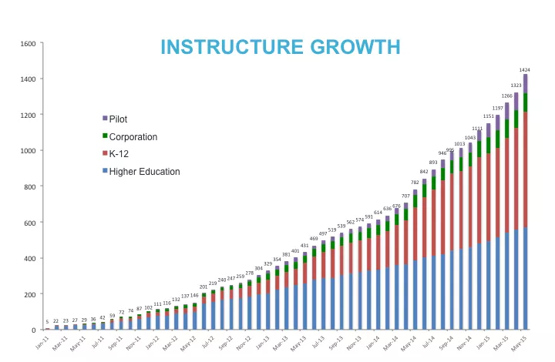

Slide 29


Slide 30
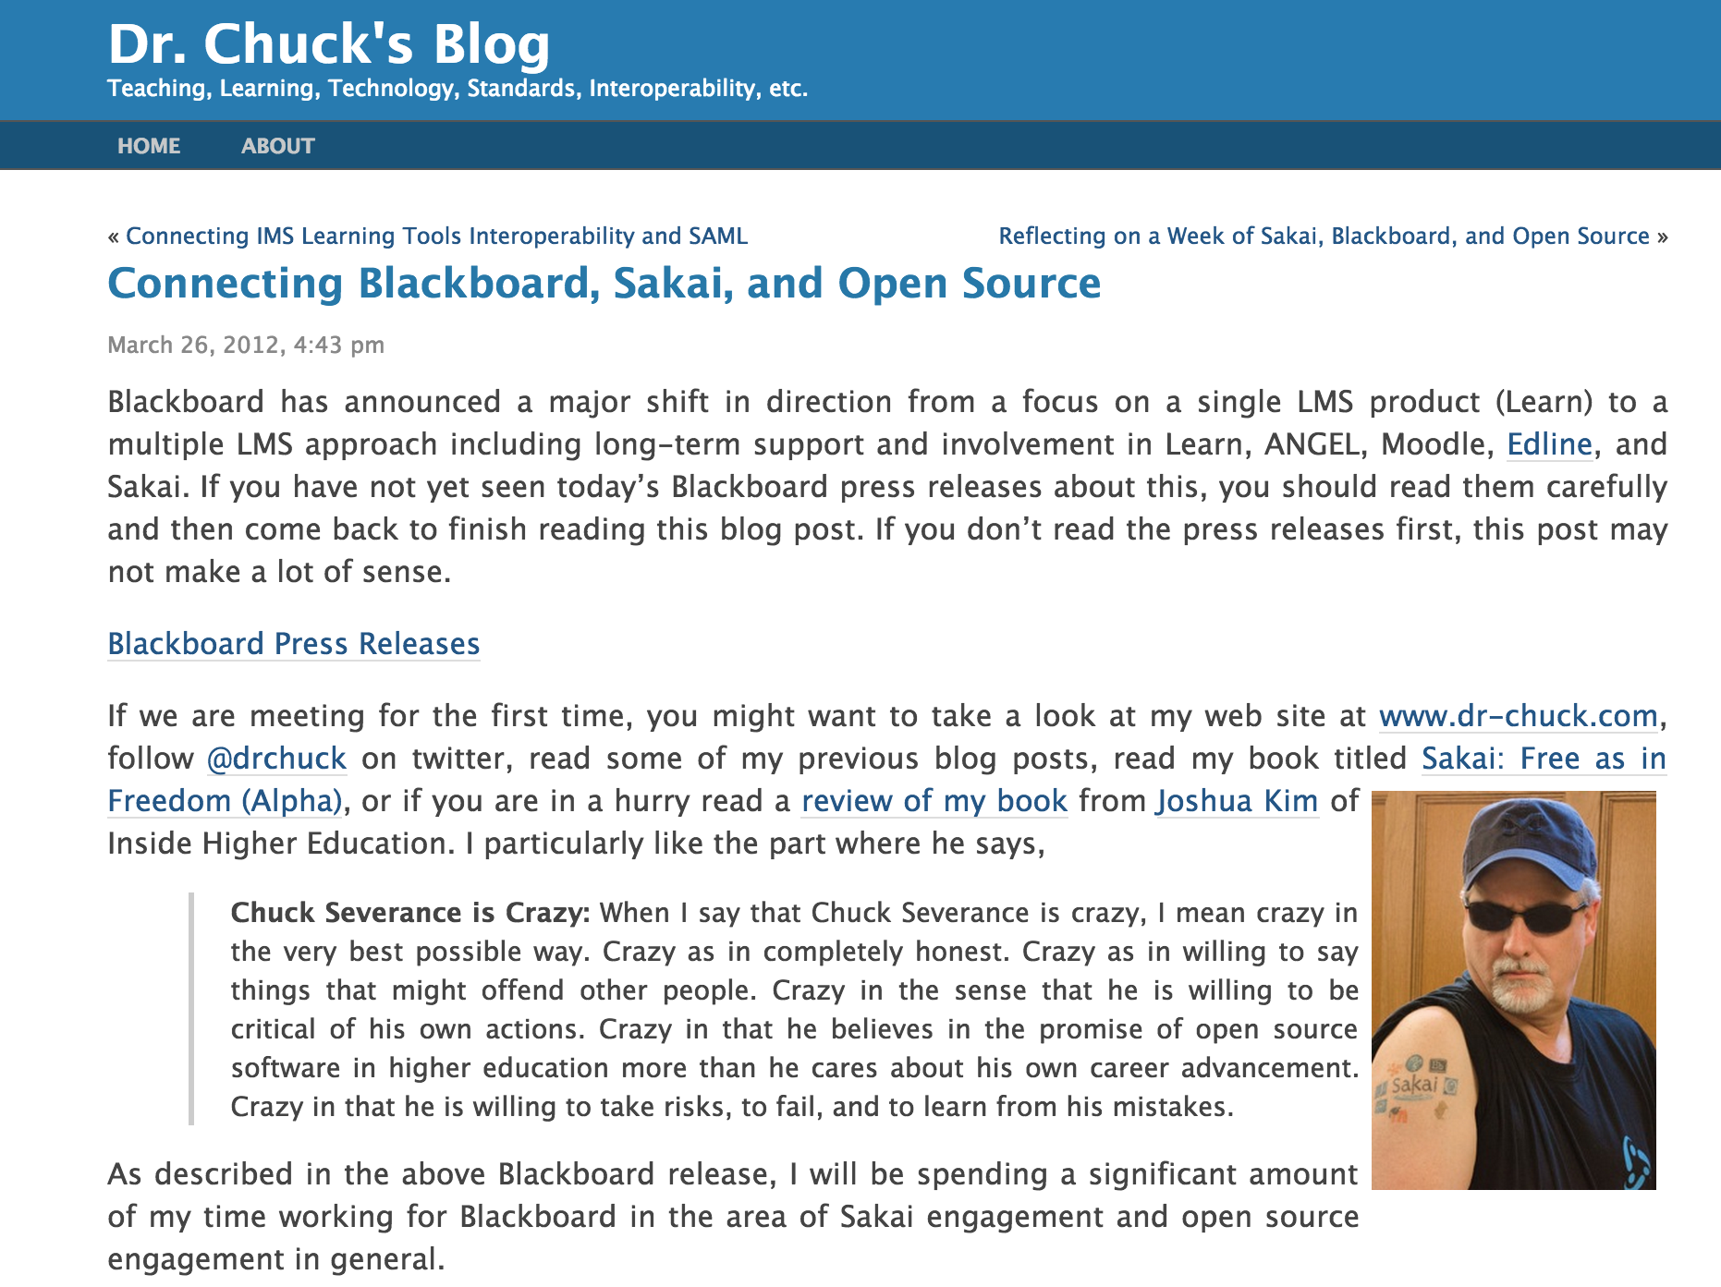

Slide 32
Act 1 - Summary

Slide 33
Act 2 - Summary

Slide 34
But there is more...

Slide 35
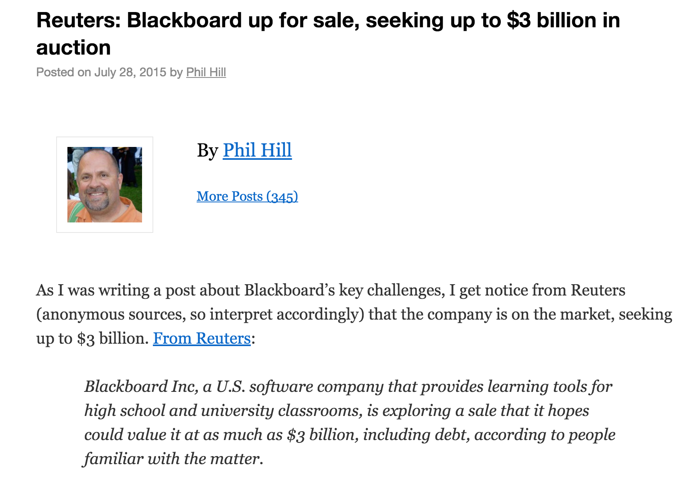
http://mfeldstein.com/reuters-blackboard-up-for-sale-seeking-up-to-3-billion-in-auction/

Slide 36
A Three-Act LMS Play
https://en.wikipedia.org/wiki/Three-act_structure

Slide 37
D'Arcy Norman's Law of eLearning Tool Convergence
Any eLearning tool, no matter how openly designed, will eventually become indistinguishable from a Learning Management System once a threshold of supported use-cases has been reached.
http://darcynorman.net/2013/02/15/normans-law-of-elearning-tool-convergence/

Slide 38
Canvas Advantages
Rewrite in 2008 – this does not last
Standards-first approach
Embrace-Extend-Enhance
Dis-intermediate local LMS admin – empower the teacher

Slide 39
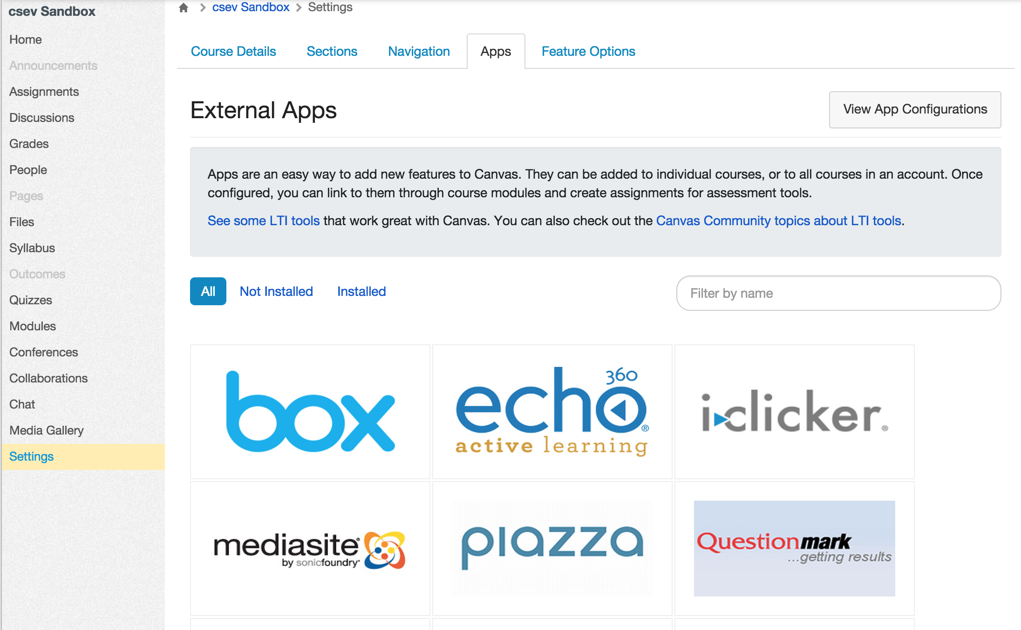

Slide 40
Future Structure
The power structure in the market place is shifting
It is no longer about one more feature in the LMS
It is about the number and quality of external tool integrations

Slide 41
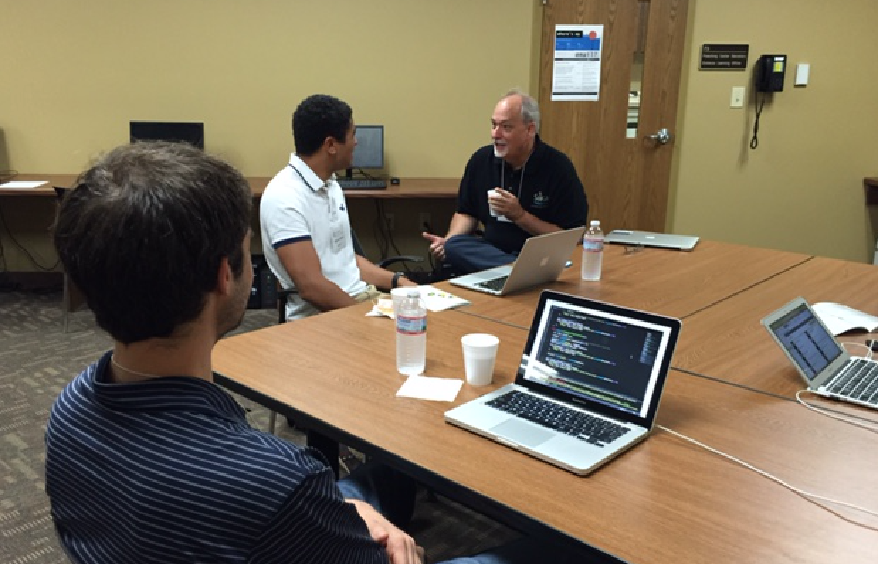
Notes:
Monte Jeff of WarpWire

Slide 42
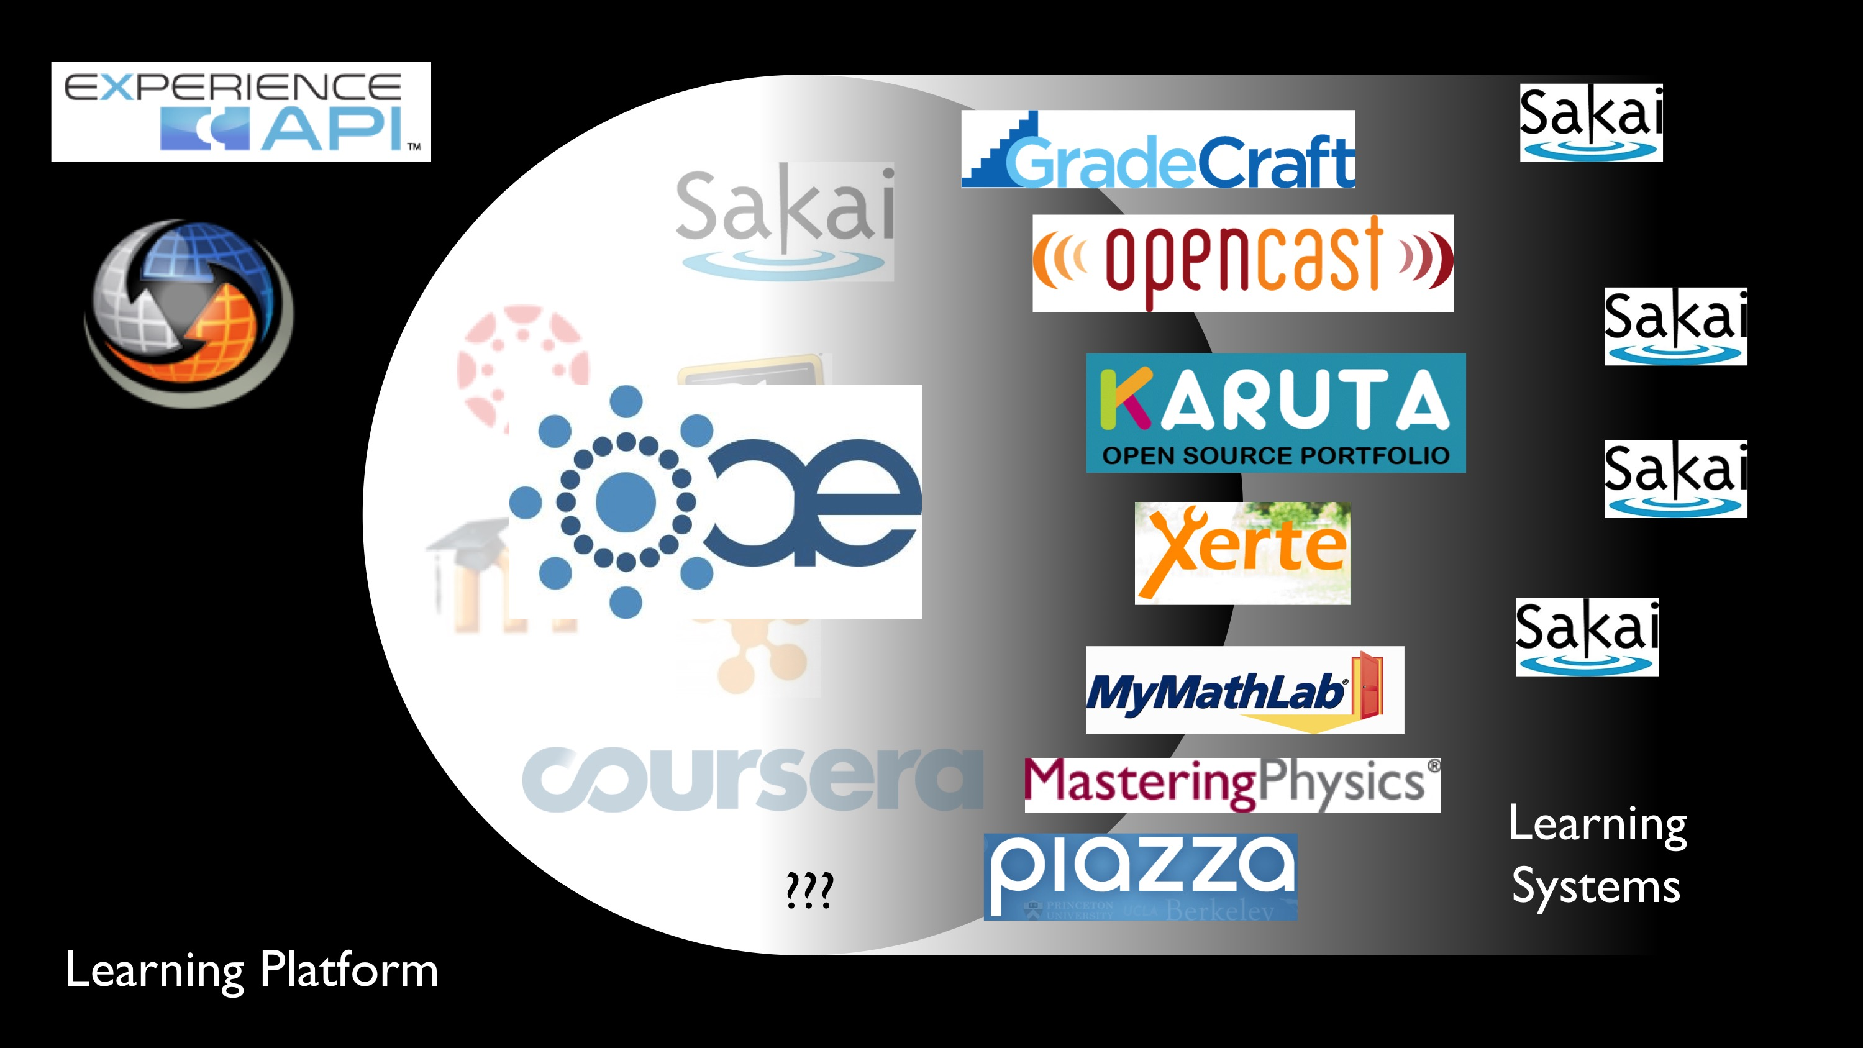
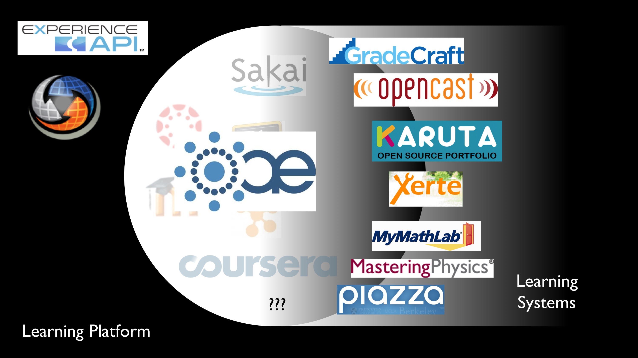
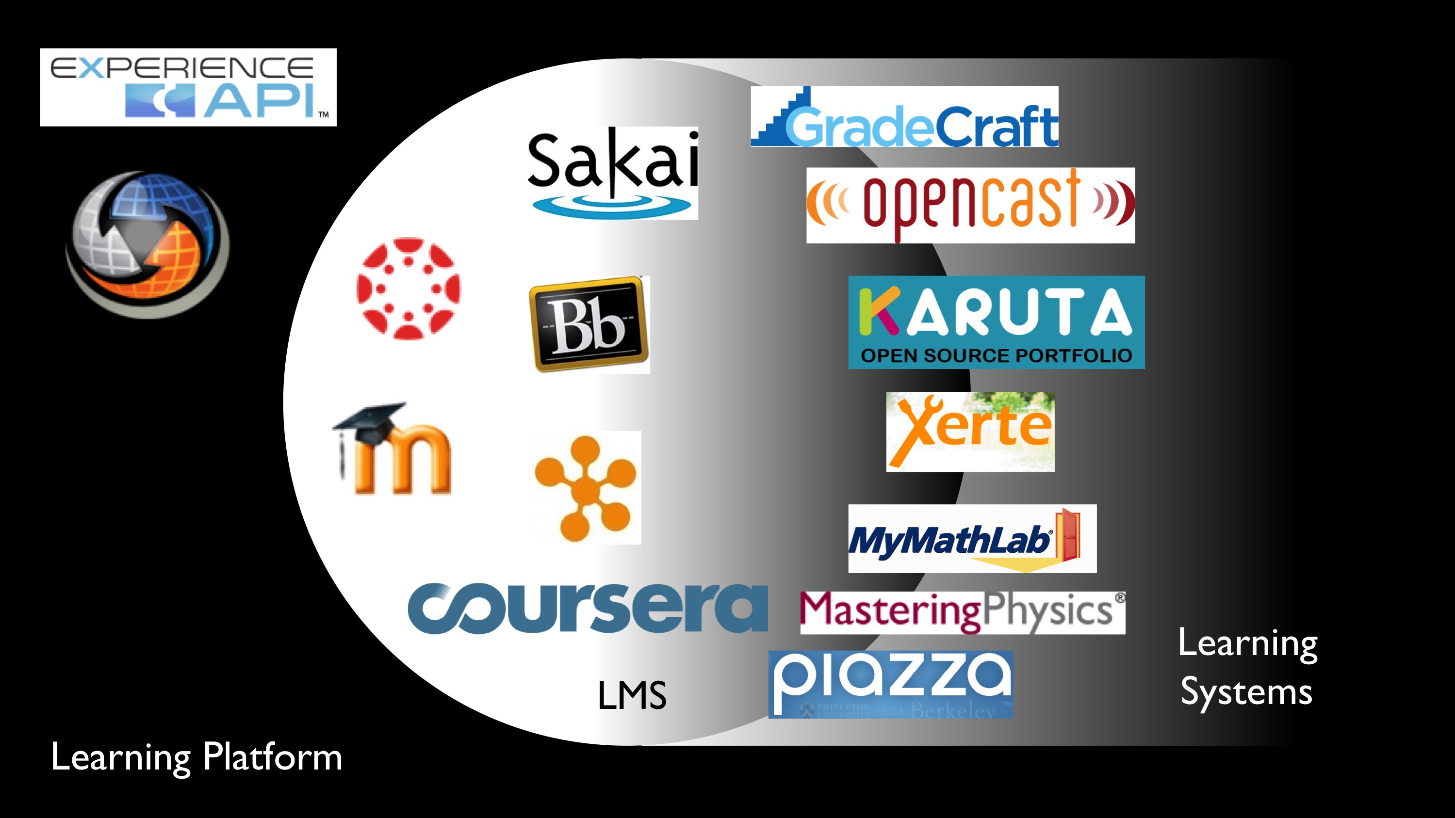
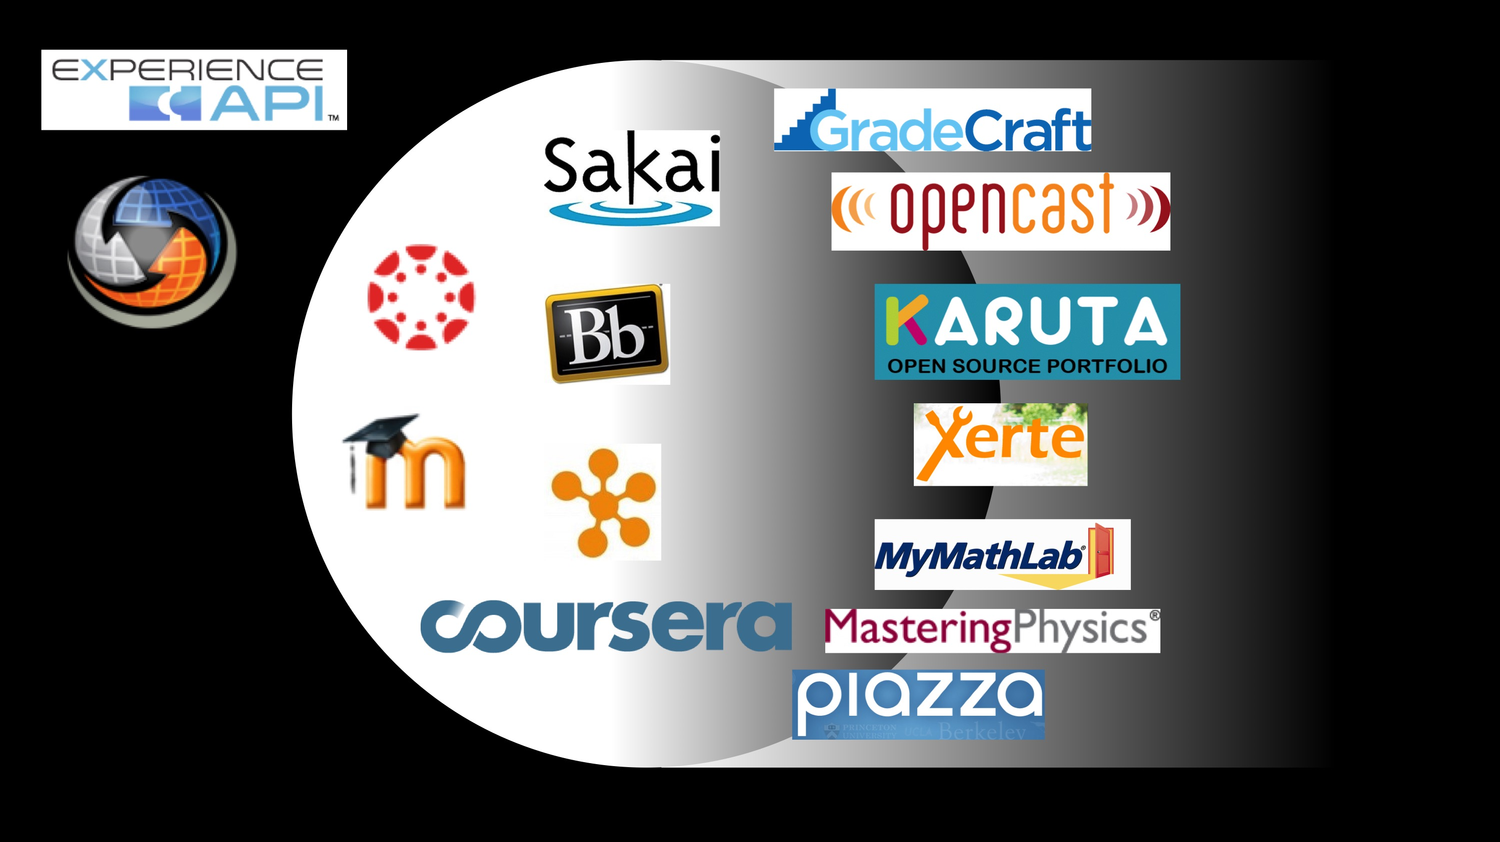

Slide 44

?

Slide 45
????

Slide 46
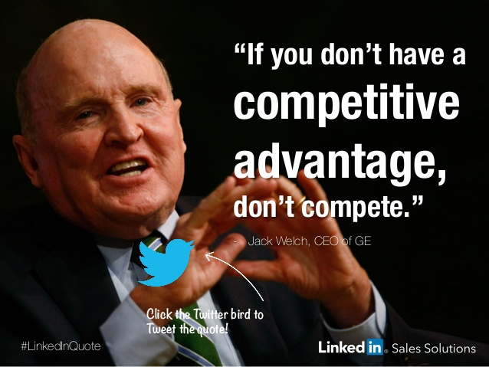

Slide 47
????
Notes:
From the one comes many

Slide 48
Path to The Future
Better Standards
Beautiful and rich integrations
Teacher-centered ecosystem of tools and content
Interoperable application stores - real
Un-bundling

Slide 49
http://mfeldstein.com/back-to-the-future-looking-at-lms-forecasts-from-2011-2014/

Slide 50
A Three-Act LMS Play
https://en.wikipedia.org/wiki/Three-act_structure

Slide 51

Summary
The last decade has been tumultuous (in fast motion)
We are moving towards a position of shakeout
Don't assume anything
In the end there will be better solutions for teachers

